Slide 1
AHLTA Form Template Designer
“ITG” – Illegitimate Template Generator

Slide 2
What I want to do:
Develop a GUI designer for AHLTA Form Templates
… in C# / .NET
… with WPF
… using the MVVM pattern

Slide 3
My programming background
Introduction to Object-Oriented Programming (Java) – in 1999!
Otherwise self-taught: Delphi early on, then VB.NET, C#.NET, and VBA
Basically, I’m competent enough to make simple tools with one or two tasks.
I’ve been involved in larger projects (I was on the development team of SharpEnviro, a Windows shell replacement, as the quality leader).

Slide 4
My goals
Better understanding of software development
Better understanding of MVVM
Putting tasks in the proper layer
Understand flow of information (e.g. commands, dependency injection)
Better understanding of certain programming topics:
Delegates
Lambda expressions
Unit testing
Learn to design a complex system
Learn when (not) to use patterns

Slide 5
Project History
AHLTA supports graphical templates, but the official designer is only licensed to a handful of people, who were responsible for developing ALL templates used in the DoD. Small/custom requests are denied.
However, you can export and import templates as text files, which I gradually deciphered over several years. This let me to hand-write a custom template, but is extremely time-consuming and error-prone.
I decided to develop my own GUI designer to both solve the above problem and expand my programming skills.

Slide 6
Efforts to date:
I succeeded in creating a prototype with the basic functionality. However, this was done by incorporating code I didn’t fully understand and without a larger design strategy.
The project is sufficiently complex that I don’t understand much of my own code. It would also likely benefit from using an MVVM framework, but continuing the old version doesn’t seem wise at this point.

Slide 7
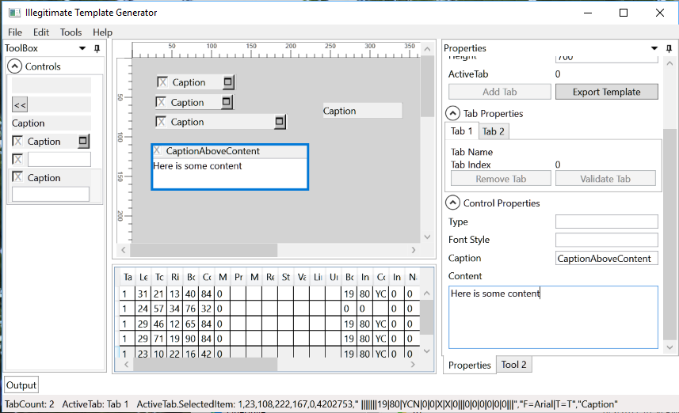

Slide 8
Back to the drawing board …
I would like to start over, with a proper design and incremental plan, and take the time to learn the concepts along the way.
This is for my own learning, with no deadlines. However, it will also let me explore some informatics themes, such as:
How to display and interact with complex data structures
How to separate the user experience (data display) from the data itself
Understand the limitations of current interface designs in interacting with complex data, from a usability perspective (e.g., custom controls that are unfamiliar to users often impede workflow, even if existing control paradigms create awkward workflows)

Slide 9
Necessary features
Drag-and-drop controls onto a canvas, where they can be dynamically manipulated (size, position, captions, colors)
Display the text representation of the control
The control and its text representation need to dynamically respond to changes in the other.
The controls’ appearance must be dynamically generated
Save existing project (without exporting)
Export to Form Template text file
Import existing template and display on canvas

Slide 10
Desired features
Ability to assemble new controls within the designer from user-selected components (e.g. build a control featuring a label, “yes/no” checkboxes on the left side, and text field)
Generates preview of single text lines if user wants to copy one in (to verify what it looks like)
Designer canvas has pixel rulers that show mouse position
Designer canvas can align controls
Designer canvas has “snap-to-grid” option

Slide 11
Does NOT need …
Any kind of networking/connectivity support
Localization
Support for other platforms

Slide 12

Example control structure
1,260,60,430,80,115033,8449,"AD|||||||19|80|YCN|0|0|X|X|0|||0|0|1|0|0||||","F=Arial|K=16777215|T=T",“Overflow HPI~Content“
… represents
Prefix (“AD|||||…”), ItemData (“F=Arial|K=…”), and Description (“Overflow HPI~Content”) are containers for even more properties
POSITION | ITEM | TYPE | DESCRIPTION
00 | Page | int | The page (tab) this item appears on
01 | Left | long | X coordinate of left edge
02 | Top | long | Y coordinate of top edge
03 | Right | long | X coordinate of right edge
04 | Bottom | long | Y coordinate of bottom edge
05 | MedcinID | string | Associated Medcin finding (0 if not associated with a Medcin finding)
06 | Flags | long | Control type
07 | Prefix | string | Control parameters, particularly display/layout
08 | ItemData | string | Additional control parameters, particularly font properties and colors
09 | Description | string | Additional control parameters, particularly caption/text

Slide 13
Subprojects
The following slides show related tools I built that would ideally be available in a comprehensive designer.
In some cases, they could be incorporated as a feature transparent to the user (e.g. color selection), or as a separate tool accessible from the menu bar (e.g. Medcin library editor)

Slide 14
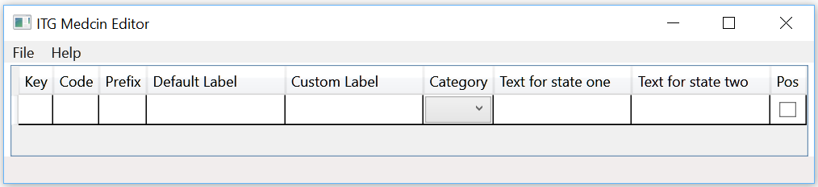
Medcin Library Editor
Maintain and edit catalog of Medcin items
Most template items are tied to a Medcin code

Slide 15
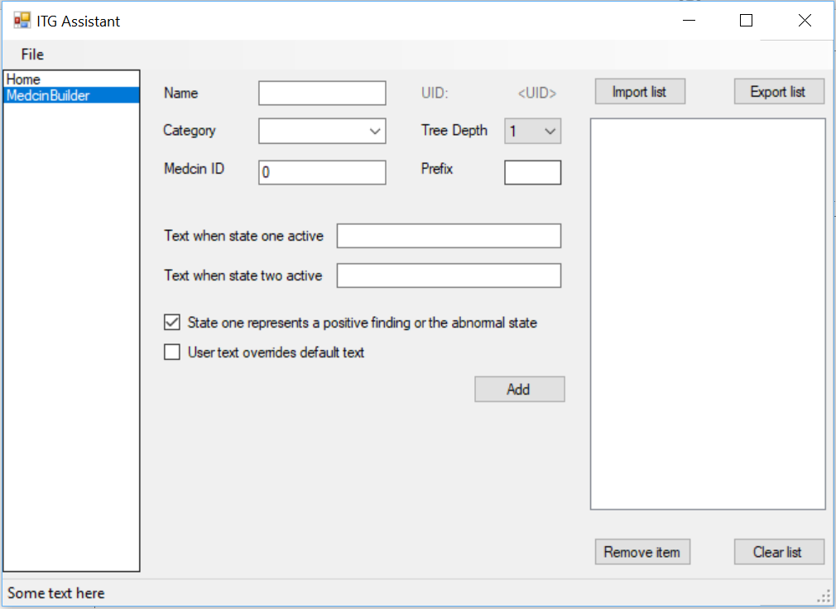
Medcin Item Editor

Slide 16
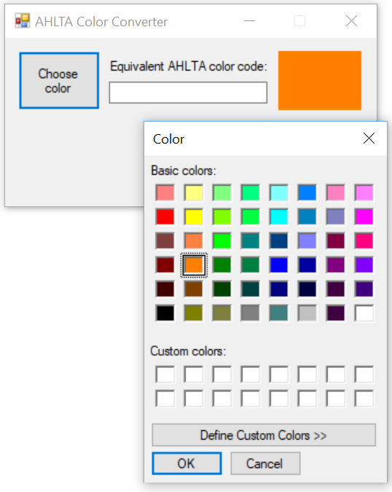
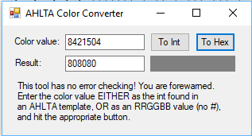
Color Converter
Templates use some ass-backwards
int value to represent colors

Slide 17
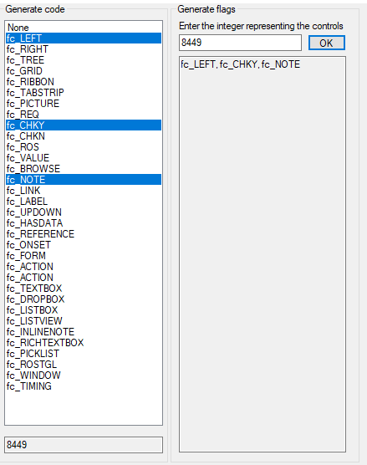
Control Flag Decoder
Lets you enter a code from an existing
template and see its components
Conversely, select the components to
generate the flag code.

Slide 18
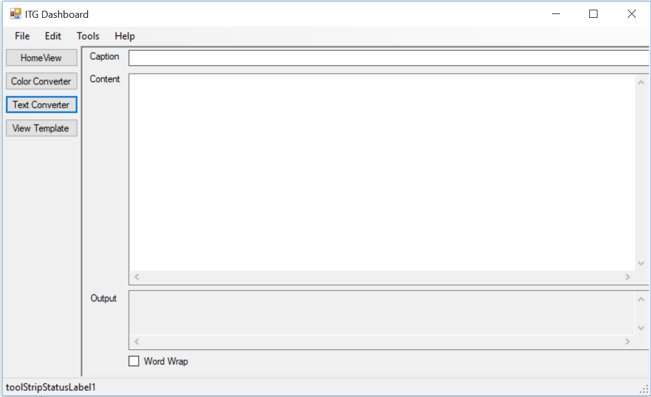
“Bonus Project”
I’d like to develop a WPF shell to contain small projects – basically, develop the other projects as modules that can be loaded by the shell.
Would provide a useful testing ground to build small/separate tools before integrating them in a larger project

